Slide 1
DINO JUMP
Agrima Shahi(THA080BEI004)
Samiksha Dhakal(THA080BEI038)
Shristi Mallik(THA080BEI044)
Department of Electronics and Computer Engineering
Tribhuvan University
Thapathali Campus
2081-01-20

Slide 2

IN DINO GAME IT IS NOT THE DINOSAUR THAT RUNS BUT THE GROUND THAT MOVES!!!

Slide 3
MOTIVATION
Challenge to create dino game using different programming language.
Challenge to recreate dino using C Programmming language.
To simplify code of dino game.
To explore game development center.

Slide 4
OBJECTIVE
- To enhance our programming abilities in the C language .
- To develop and present a dinosaur game using C language concepts
- To pursue similar endeavors and improving problem-solving skills.

Slide 5

Development Process
Let's get a sneak peek behind the curtain to see how our game came to life!

Slide 6
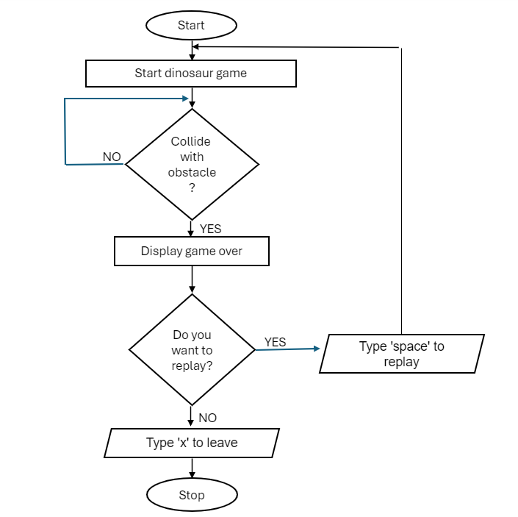
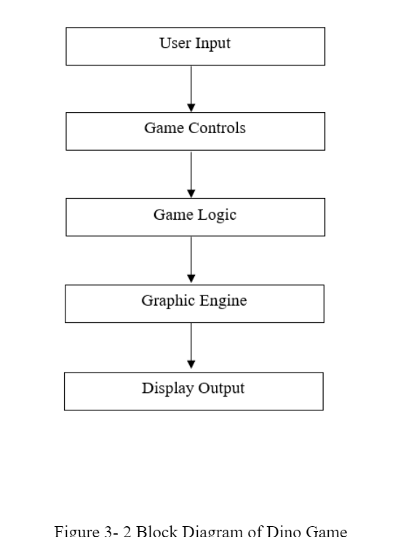
Program flowchart:

Slide 7
Initialization
•Setting console dimensions and displaying game info.
•Initialization of dinosaur and obstacle positions.
•Prompting the user to start the game.

Slide 8
Character Movement
•Implementation of the 'ds' function to animate the dinosaur.
•Adjustment of the dinosaur's vertical position for jumping and falling.
•Usage of 'gotoxy' function to print the dinosaur's ASCII art representation.
•Regulation of animation speed with the 'delay' function.

Slide 9
Obstacle Generation
•Manual placement of fixed obstacles on the screen.
•Horizontal movement of obstacles.
•Continuation of obstacle generation to create the illusion of continuous obstacles.

Slide 10
Collision Detection
•Comparison of bounding boxes of the dinosaur and obstacle to detect collisions.
•Transition to a "game over" state upon collision.
•Display of final score and prompt for replay.

Slide 11
User Input Handling
•Continuous loop for user input within the 'main()' function.
•Execution of jump upon pressing the space key.
•Termination of the game upon pressing 'X'.

Slide 12
Game Loop
•Implementation of continuous loops and conditional statements within 'main()' function.
•Waiting for user input to start the game.
•Continuous updating of game state
•Termination of the game loop upon user input of 'X'.

Slide 13
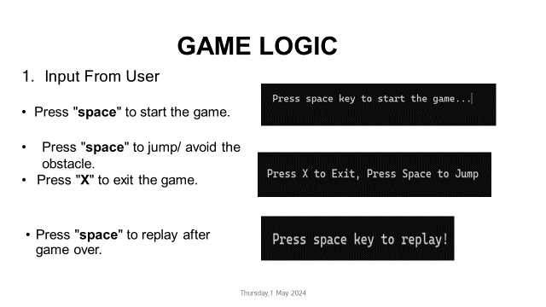
GAME LOGIC
Input from User
Press "space" to start the game.
Press "space" to jump/ avoid the obstacle.
Press "X" to exit the game.
Press "space" to replay.

Slide 14
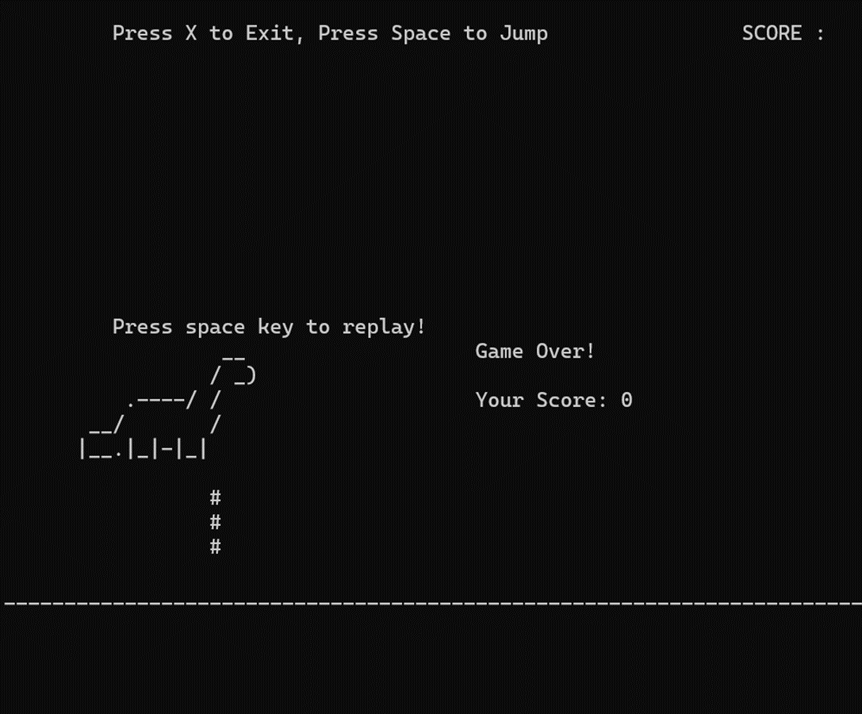
If dinosaur touches the obstacle, computer shows:
Game Over!
Your Score: ##

Slide 15
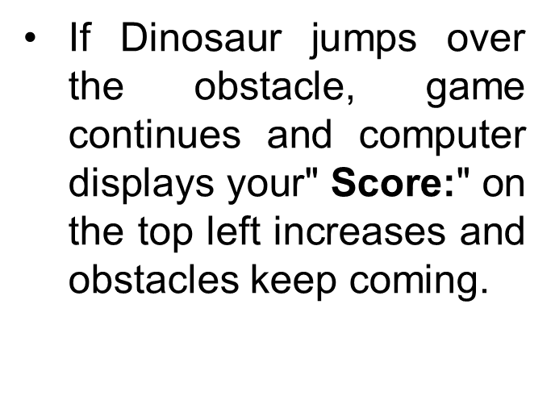
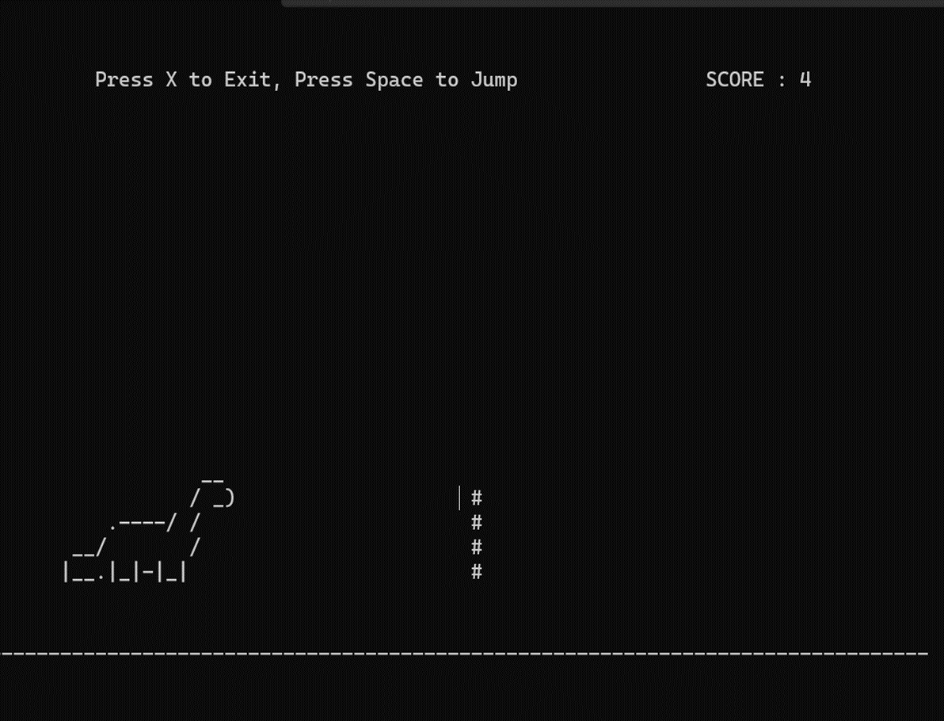

Slide 16
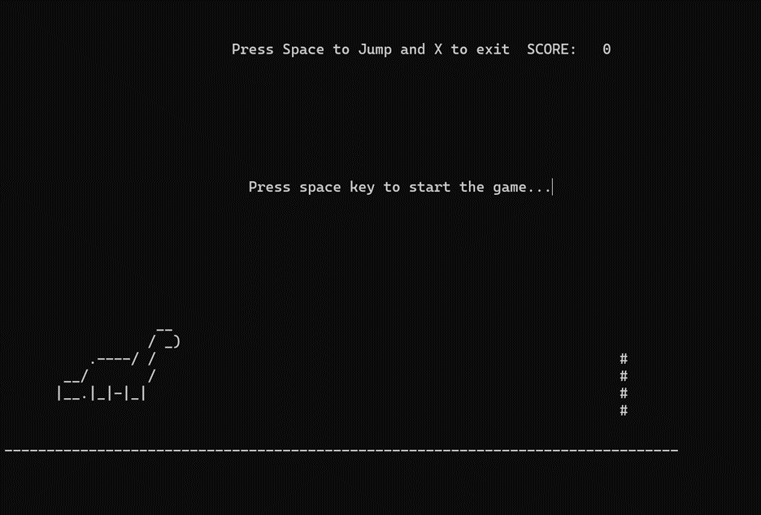
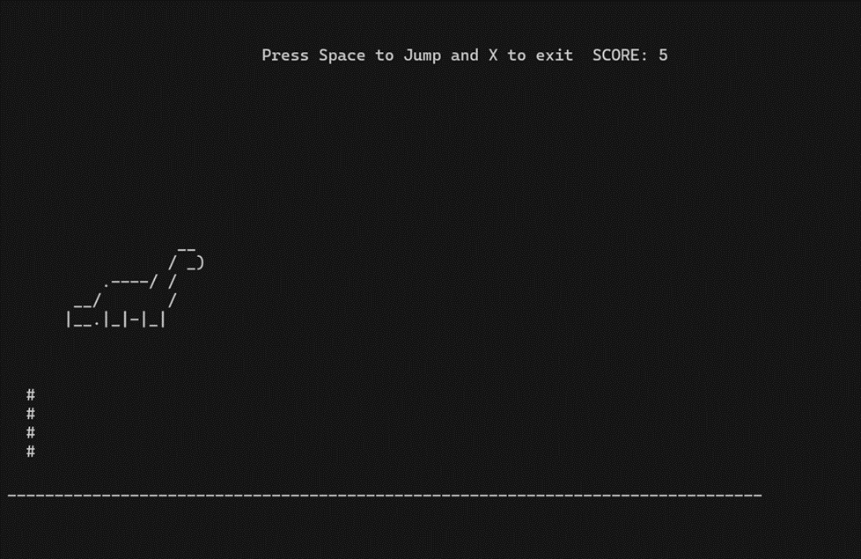
RESULT AND ANALYSIS
Image: Game Processing
Image: Asking user to start the game

Slide 17
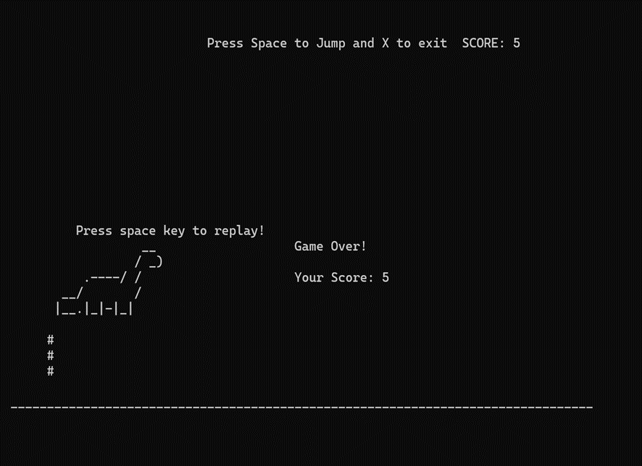


Slide 18
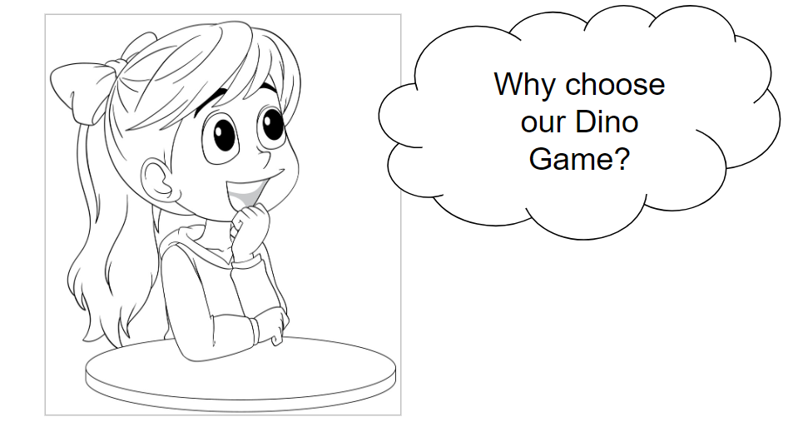

Slide 19
LIMITATIONS
Limited Gameplay Variety(less features)
Graphical Complexity( visually stimulating games )
Device Compatibility(accessibility issues)
Limited Social Features(community)
Monotonous Progression(reward)
Technical Constraints(technical limitations)
Lack of Storyline(compelling storyline)

Slide 20
FURTHER ENHANCEMENT
Multiplayer Mode.(real-time collaboration )
Power-Ups and Abilities. Implementing power-ups and special abilities that players can
Customization Options. (sense of personalization) and progression.
Interactive Environments. (destructible obstacles, moving platforms, weather effects )
Storyline and Quests.(engagement)
Achievements and Challenges. (challenges and quests)
Social Features.
Advanced Graphics and Effects.

Slide 21
PROJECT APPLICATION
Recreation and Entertainment
Algorithm Implementation
Debugging and Testing Skills
Skill Development

Slide 22
CONCLUSION
Challenging yet rewarding experience
Technical challenges that we overcame through collaborative effort
Game development using the fundamental concepts of c language
Implemented features like dynamic obstacle generation, scoring mechanics and responsive user control
Teamwork, time management, and continuous iteration
Further enhancement(multiplayer, graphics, difficulty level)

Slide 23
TENATIVE TIME
TASKS | Week1 | Week2 | Week3 | Week4 | Week5(submission date)
Project discussion
Project research
Documentation
Pseudo coding
Coding
Debugging

Slide 24
PROJECT EXPENSES
There were no project costs incurred as this project solely relied on fundamental C programming principles and was executed using basic IDE functionalities. Any future improvements ie; graphic uses, extra functions, etc. may involve expenses depending on the nature of the updates.

Slide 25
REFERENCES
G. Bateson, “History of the Dinosaur Game” [Online]. Available: The Origins of Chrome Dino Game – From Past to Present (coolmathgames.com) [Accessed 29 March 2024]
T. Ruchandani, T. Tarihalkar, W. He and M. Shunde, “F19 T-Rex Run” [Online]. Available: http://socialledge.com/sjsu/index.php/F19:_T-Rex_Run! [Accessed 30 March 2024]
J. Bhatia, “6 Benefits of Using C and C++ for Game Development” [Online]. Available: https://pwskills.com/blog/c-for-game-development/#:~:text=C%20is%20a%20viable%20choice,those%20who%20prefer%20manual%20control. [Accessed 25 March 2024]

Slide 26
THANK YOU!

